Slide 1

CAF Hackathon Advanced
Session 1 – Intro Enterprise Scale

Slide 2
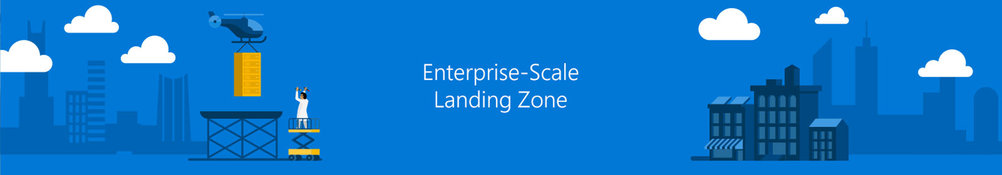
Photo layout 1
Session - Enterprise Scale Einführung
AGENDA
Introduction
Design principles
Design areas
Implementation Guide

Slide 3
Introduction

Slide 4
Plan
An iterative process that supports your business … as it evolves
Govern
Manage
Define strategy
Adopt
Ready
Notes:
<Key point>: An iterative process that supports your business needs.
We can help you on your cloud adoption journey.
We put the experience of employees, partners, and customers to work for you.
We work together with you—to build your plan for cloud adoption.
It starts with your vision.
Crystallize your vision for cloud adoption by working cross-functionally with your finance, marketing, sales, and HR departments.
Work to gain consensus on:
Clear motivations: Why are we adopting the cloud?
Defined business outcomes: What results do we expect to see from adopting the cloud?
Business justification: How will the business measure success?
We work with you to build an actionable cloud adoption plan with strategic (above) and tactical inputs such as defining your workloads and assets, aligning your organization, and readying necessary skills.
This cross-team effort is balanced out by the technical team, who will take this vision and execute technical deployment.
We recommend iterative planning to drive your cloud adoption effort—enabling your technical teams to move incrementally, in phases towards cloud adoption.
<move to the Ready phase to explain another example, to show iterative process, if necessary>
You plan will unite your organization in a cross-team initiative that, together, will forecast, budget, implement, and manage its success.
Our approach is Agile, and we consider security, governance, cost-optimization, and hybrid-cloud awareness by default.
Microsoft will work with you, learning how you do business—and help you adapt.
Your organization is changing—moving towards modernization, with challenging new markets, products, customer engagement.
We can help you get there.
<Transition>: What does a cloud adoption framework look like?

Slide 5
Microsoft Cloud Adoption Framework for Azure
Proven guidance to accelerate your cloud adoption journey
Define strategy
Define business justification and expected outcomes
Plan
Align actionable cloud adoption plan to business outcomes
Ready
Prepare people, process and environment for change
Adopt
Migrate / Innovate
Implement desired changes across IT and business processes
Govern
Comply, control and secure
Manage
Operate and optimize
https://aka.ms/adopt/overview
Notes:
<Key point>: Cloud Adoption Framework—modular phases of adoption.
As your organization evolves, the Cloud Adoption Framework adapts to your business needs.
Each module in the diagram is an iterative phase that advances your business through the complete lifecycle of cloud adoption.
Customers can choose the phase best-suited to their degree of cloud adoption maturity. The Cloud Adoption Framework offers a guiding methodology to cloud adoption, with specific approaches to overcoming common blockers to cloud adoption in each module, such as “Define Strategy,” “Plan,”, etc.
The Cloud Adoption Framework offers the enterprise a modular framework of how to incrementally onboard to the cloud.
Cloud adoption shifts how companies obtain, make use of, and lock down their technology resources.
And—this kind of modular framework flips the model of how enterprises operate:
Transitions organizations to need-based consumption of technology resources
Change from cap-ex (capital expenditure) to op-ex (operating expenditure) model
Cloud model assumes security, governance, cost-optimization, and hybrid cloud by default
Develop a future-ready workforce—developing and deploying cloud skill readiness organization-wide
As an organization progresses through the Cloud Adoption Framework, what are the main goals of each methodology of “Define Strategy,” “Plan,” you can focus efforts on?
<Transition>: Let’s look at some possible motivations for cloud adoption, and what some common blockers are that the Cloud Adoption Framework can help you resolve.

Slide 6
Unlocking - Ready
Define strategy
expected outcomes
Plan
Ready
Adopt
Migrate or Innovate
Landing zone Blueprints
Need a fast way to configure my Azure environment
Govern
Manage

Slide 7



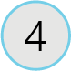
Ready
The ‘Ready’ module establishes a cloud foundation or adoption target that can provide hosting for any adoption efforts.
Azure setup guide
Azure setup guidance on the tools and approaches you need to create a landing zone
First landing zone
Choose the most appropriate landing zone option to establish a code-based starting point for your environment
Expand the landing zone
Meet the platform considerations of your cloud adoption plan by expanding your landing zone
Best practices
Validate landing zone modifications against best practices
Notes:
Ref: https://docs.microsoft.com/en-us/azure/cloud-adoption-framework/ready/
To get you Ready to deploy your first workloads on Azure, there are four exercises that help guide you.

Slide 8
Ready
Define strategy
Plan
Ready
Adopt
Ready establishes a cloud foundation or Adoption Target that can provide hosting for any adoption efforts. This should consist of common denominators across 80–90% of cloud adoption.
Govern
Manage
Azure readiness guide
Resource management: management groups, subscriptions, resource groups, resources tree hierarchy
Naming Standards
Resource tags
Landing zone infrastructure
Network design: Vnet, hybrid, firewall, hub, front door, endpoints
Storage design: disk, file, blobs, CDN
Compute design: VMs, containers, apps, serverless
Data design: Structured/ unstructured
Landing zone ID
Identity and access
Role-based access control RBAC
Manage to least privilege
Landing zone cost
Costs and billing
Analyze Cloud Costs
Monitor with budgets
Optimize with recommendations
Manage invoices and payments
Blueprints
AI
BigData
Hybrid networks
Identity management
IoT
Serverless
SAP
VMs
WebApps
DevOps

Slide 9

Azure landing zones help customers set up their Azure environment for scale, security, governance, networking, and identity.
Azure landing zones:
Enable migrations and net new apps
Consider all platform resources
Don’t differentiate between IaaS or PaaS

Slide 10
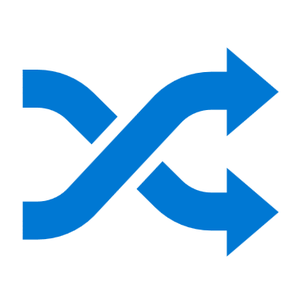




The value of creating cloud-ready environments
Aligned to business priorities
Cloud-design considerations
Adapted for cloud operating model
Ready for cloud applications
Adaptable to grow and expand
Compliant
Agile
Cutting-edge innovation
Secure
Notes:
<Key point>: Constructing a cloud-ready environment is like building a house structurally up to code.
If a customer wants to build an app in the cloud, we must build the environment that helps them deliver on their business priorities.
What is the cloud operating model that is running the application?
We must ensure that the environment scales as the application becomes more robust and more complex.
And of course, the cloud environment must be compliant.
Cloud-ready environments help customers to become agile, make use of innovative technologies, and remain secure.
<Transition>: Let’s look at how Azure landing zones help customers.

Slide 11
What is Enterprise-scale?

Slide 12


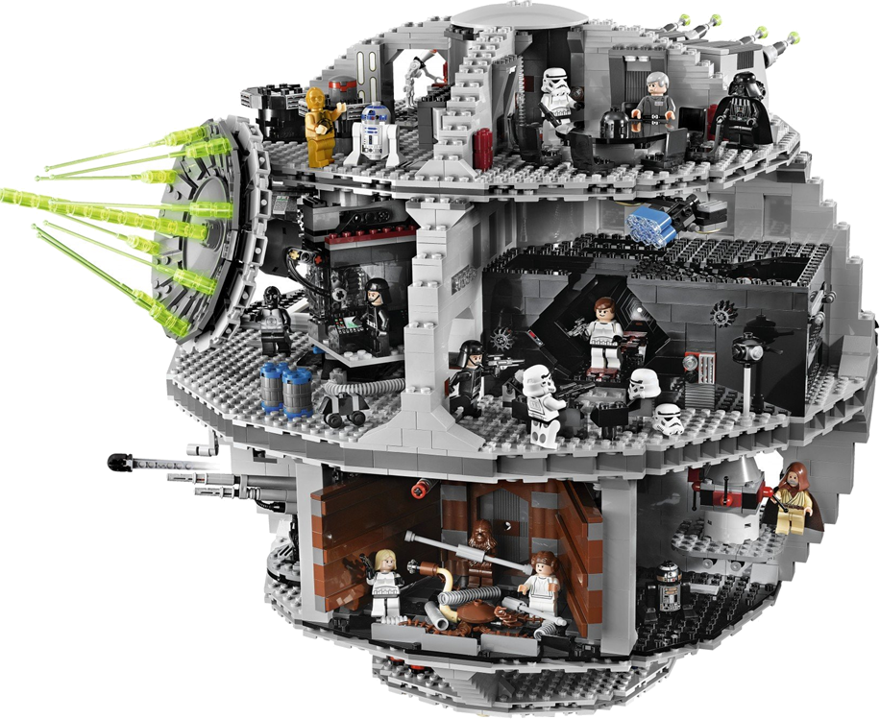


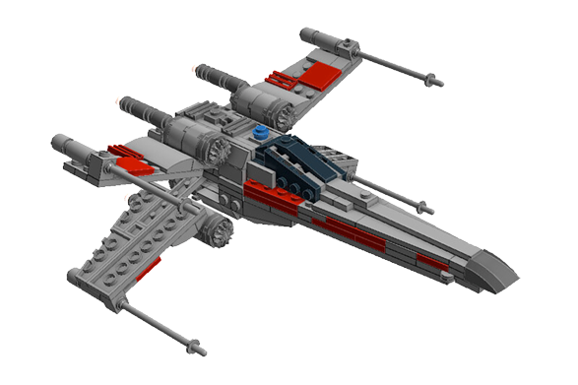
Building Data Center on Azure
Workload
in the Cloud
DC in the Cloud
At Scale
Notes:
Cloudifcation is also about building Poste Italiane cloud on Azure – on your terms!
Most organizations that move quickly focus on one workload, however when we want to address an entire DC migration this iterative by workload adoption will suffer delays in the journey because in order to move a complete DC you need the complete vision of what needs to be designed and built for. Designing the Platform for our Datacentre regardless of workloads that will eventually run in production. A scalable, agile Plapform design.

Slide 13

Metropolis
Using an analogy, this is like how city utilities such as water, gas, and electricity are accessible before new houses are constructed. In this context, the network, IAM, policies, management, and monitoring are shared 'utility' services that must be readily available to help streamline the application transformation process.

Slide 14



Key Challenges
Architecture Complexity: Customers lack the required level of understanding and experience on Azure. The mismatch between on-premises infrastructure and cloud-design considerations creates dissonance and friction with respect to defining architectures and standards for their migration to the cloud. They are struggling with the translation of their requirements to Azure concepts, capabilities, constructs and security model.
Operating Compatibility: Existing approaches and functions for the traditional delivery and management of IT services are not compatible with the Azure platform and cloud operating models. When combined with a lack of skills and experience, customers are struggling to define and therefore transform their operating model to manage and support large-scale cloud infrastructure.
Lack of Trust and Desire for Control: The absence of a precise and detailed cloud architecture that is compliant with their requirements, and the lack of a well-defined operating model to support such a platform, leads IT not to trust Azure and instead strive to maintain full control. This often involves building ‘walls’ and complicated processes which ultimately get in the way of business lines adopting Azure.

Slide 15
Enterprise-scale?
Enterprise-scale is an architecture approach and reference implementation that enables effective construction and operationalization of landing zones on Azure, at scale and aligned with Azure Roadmap and Microsoft Cloud Adoption Framework for Azure.
Authoritative Provides holistic design decision framework for Azure Platform.
Proven
Based on success of large-scale migration projects at-scale.
Prescriptive Apply this on "Monday Morning" in your Azure environment.
Enterprise-scale Architecture:
Enterprise-scale design principles: Principles to help/guide you customize the design.
Enterprise-scale design guidelines: Guidelines (decisions and recommendations) for the 8 components of the enterprise-scale architecture
Enterprise-scale Implementation guide: The way you create those things using reference implementation in GitHub and the deployment pipeline
Enterprise-scale Reference Implementation:
Enterprise-scale foundation: A reference implementation of shared services containing network, security, identity, governance services required to construct and operationalize an enterprise-scale landing zone
Enterprise-scale landing zone(s): A reference implementation of a workload environment conforming to the enterprise-scale architecture (opinionated way to implement, code)
https://aka.ms/enterprisescale
Notes:
Enterprise-scale comes in two buckets
The Architecture – What must be true? This is our Microsoft opinion on what should be done based on really world work with our strategic customers.
The reference implementation – This is a first partner example on how this could be implemented. You do not have to use this reference implementation if you are following the design guidelines and principles.
In the rest of the session, we’ll discuss these 5 elements.

Slide 16
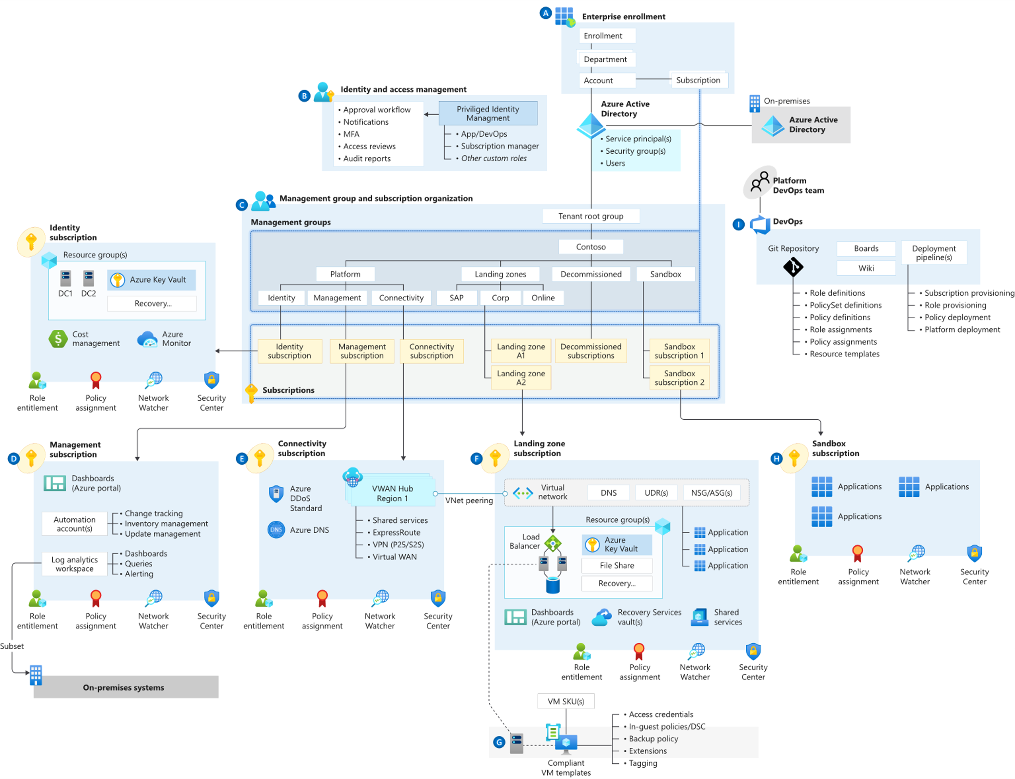
Enterprise-scale
The Big Picture (reference design)

Slide 17
Enterprise-scale landing zone(s)
The principal purpose of the “Landing Zone” is therefore to ensure that when an application or workload lands on Azure, the required “plumbing” is already in place, providing greater agility and compliance with enterprise security and governance requirements.

Slide 18
Design principles

Slide 19
Enterprise-scale Design Principles
Subscription Democratisation
Policy Driven Governance
Single Control and Management Plane
Application Centric and Archetype-Neutral
Azure Native Design and Platform Roadmap Alignment
Enable Autonomy for Innovation and Transformation
Security and Compliance By-Default
Governance At-Scale with Sustainable Cloud Engineering
Notes:
Subscriptions should be used as a unit of management and scale aligned with business needs and priorities.
Azure Policy should be used to provide the “guard-rails” and ensure the continued compliance of the customer platform and applications deployed onto it, whilst also providing application owners sufficient freedom and a secure unhindered path to cloud.
The “North Star” architecture should not consider any abstraction layers such as customer developed portals or tooling and should provide a consistent experience for both AppOps (centrally managed operation teams) and DevOps (dedicated application operation teams).
The “North Star” architecture should focus on application centric migrations and development rather than a pure infrastructure “lift and shift” migration (i.e. movement of virtual machines) and should not differentiate between old/new applications or IaaS/PaaS applications.
The North Star architecture strongly advocates the use of native platform services and capabilities wherever possible, which should be fully aligned with Azure platform roadmaps from the offset to ensure new capabilities are swiftly made available within customer environments.

Slide 20
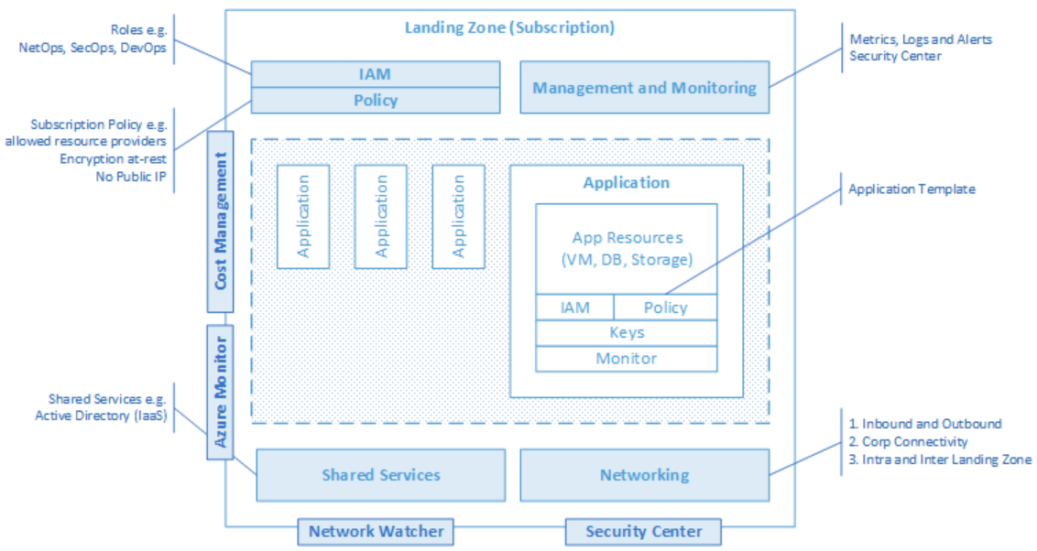
Enterprise-scale Design Principles
Subscription Democratisation
Policy Driven Governance
Single Control and Management Plane
Application Centric and Archetype-Neutral
Azure Native Design and Platform Roadmap Alignment
Subscriptions should be used as a unit of management and scale aligned with business needs and priorities, to support business areas and portfolio owners to accelerate application migrations and new application development.
Notes:
Subscriptions should be used as a unit of management and scale aligned with business needs and priorities.
Democratization, Business can choose when they move, we want agility and velocity bult into the platform to accelerate an organizations journey.
Democratisation: Subscriptions, aligned with the platform architecture, must be unblocked and provided to business lines for the design and dev/test of migrating workloads.
Subscription democratisation across the regions Customer 1 resource group – fill and spill, Pinning subscription to region. Big can start small.
Agree at the top Level Criteria for a File>New Subscription and Requirements
Plan Top down Management and unit of Management is the Subscription. This helps to address things such as subscription Limits, maybe for a workload or service we need multiple subscriptions.

Slide 21
Enterprise-scale Design Principles
Azure Policy should be used to provide the guard-rails and ensure the continued compliance of the customer platform and applications deployed onto it, whilst also providing application owners sufficient freedom and a secure unhindered path to cloud.
Subscription Democratisation
Policy Driven Governance
Single Control and Management Plane
Application Centric and Archetype-Neutral
Azure Native Design and Platform Roadmap Alignment
Notes:
Azure Policy should be used to provide the “guard-rails” and ensure the continued compliance of the customer platform and applications deployed onto it, whilst also providing application owners sufficient freedom and a secure unhindered path to cloud.
Rule Sets, and Governance should be in code to set guard-rails. Declare the intent of the policy, Audit only vs deny designed into platform. Deploy if not exist, for configuration drift.
No Public Endpoints – deny policy, enable Audit Logging – Deploy if not exist.
Policy – VM Provisioning
The intent of Enterprise Scale to address VM configuration drift with policy to vNet with connectivity back to Corp. Ensure VM is connected to a certain OU and domain joined.
Prevent

Slide 22
Enterprise-scale Design Principles
The Enterprise-scale architecture should not consider any abstraction layers such as customer developed portals or tooling and should provide a consistent experience for both AppOps (centrally managed operation teams) and DevOps (dedicated application operation teams).
Subscription Democratisation
Policy Driven Governance
Single Control and Management Plane
Application Centric and Archetype-Neutral
Azure Native Design and Platform Roadmap Alignment
Notes:
The enterprise-scale architecture should not consider any abstraction layers such as customer developed portals or tooling and should provide a consistent experience for both AppOps (centrally managed operation teams) and DevOps (dedicated application operation teams).
Control Plane – UBS and Equinor DRM tool
User Provisioning have native access to Azure CLI, API’s, and Portal.

Slide 23
Enterprise-scale Design Principles
Subscription Democratisation
Policy Driven Governance
Single Control and Management Plane
Application Centric and Archetype-Neutral
Azure Native Design and Platform Roadmap Alignment
We should focus on application centric migrations and development rather than a pure infrastructure "lift and shift" migration (i.e. movement of virtual machines) and should not differentiate between old/new applications or IaaS/PaaS applications.
Notes:
The enterprise-scale architecture should focus on application centric migrations and development rather than a pure infrastructure “lift and shift” migration (i.e. movement of virtual machines) and should not differentiate between old/new applications or IaaS/PaaS applications.
Application Centric Migration and Agility: Support both existing application migrations and net-new application development, without discrimination between IaaS or PaaS, all while providing a consistent experience for both AppOps (centrally managed apps) and DevOps (dedicated teams) across the design and architecture outlined above
App Centric – PaaS/DbaaS
Application and workload specific design focus. Centralize Application components. Not assigned by Who needs access based on roles.

Slide 24
Enterprise-scale Design Principles
The Enterprise Scale architecture approach advocates the use of native platform services and capabilities whenever possible, which should be aligned with Azure platform roadmaps to ensure new capabilities are made available within customer environments.
Subscription Democratisation
Policy Driven Governance
Single Control and Management Plane
Application Centric and Archetype-Neutral
Azure Native Design and Platform Roadmap Alignment
Notes:
The Enterprise-scale architecture strongly advocates the use of native platform services and capabilities wherever possible, which should be fully aligned with Azure platform roadmaps from the offset to ensure new capabilities are swiftly made available within customer environments.
Native Design – H&M – PA NVA to Azure Firewall and Terraform and provider

Slide 25
Design areas
Notes:
Quick run – thru all Design Areas

Slide 26
Enterprise-scale Design Guidelines
Enterprise Enrolment & Azure AD Tenants
Identity & Access Management
Management Group & Subscription Organisation
Network Topology & Connectivity
Management & Monitoring
Business Continuity & Disaster Recovery
Security, Governance & Compliance
Platform Automation & DevOps

Slide 27
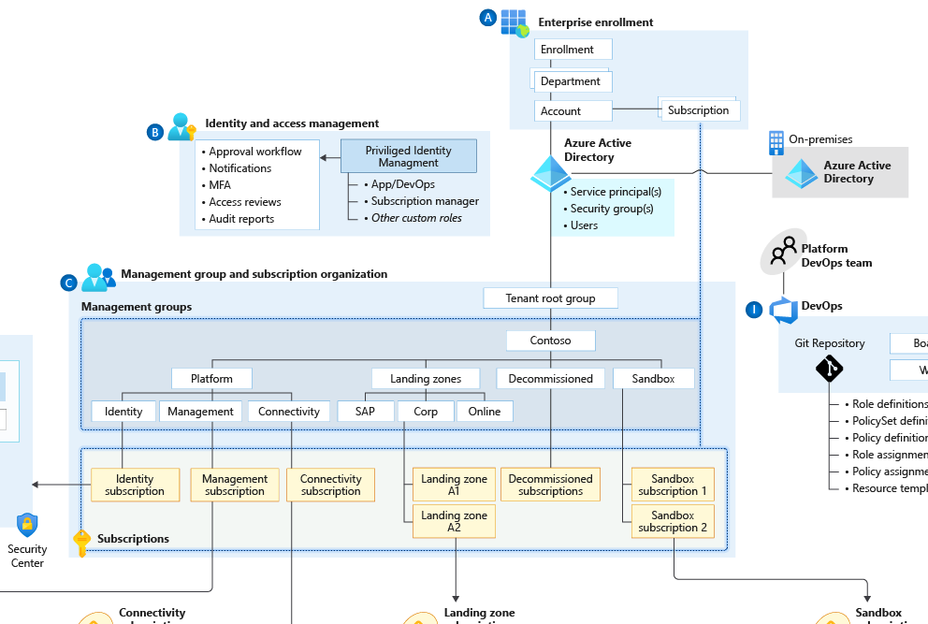

Define Azure AD Tenants
Enterprise Enrolment & Azure AD Tenants
Enterprise enrolment roles links users with their functional role and consists of
Enterprise Administrator
Department Administrator
Account Owner
Service Administrator
Notification Contact
Notes:
If they don’t have separate identity then from the platform perspective – it is just production in test.
Examples:
Department isn’t Org chart. Create Departments only if business domains have independent IT capabilities and map customer business divisions.
If multiple AAD tenants are used, ensure the Account owner is associated with the same tenant as where subscriptions from the EA account are provisioned. Separate Dev/Test/Prod environments at an EA account level to support holistic isolation.
Do not move or rename an EA Account in AD/Azure AD
Do not ignore notification emails sent to the notification account email address. Microsoft sends important EA wide communications to this account. Setup the notification account email address to ensure notifications are sent to an appropriate group mailbox.
Assign a budget for each account and establish an alert associated with the budget.
Restrict and minimise the number of Account owners within the Enrolment to avoid the proliferation of admin access to Subscriptions and associated Azure resources

Slide 28
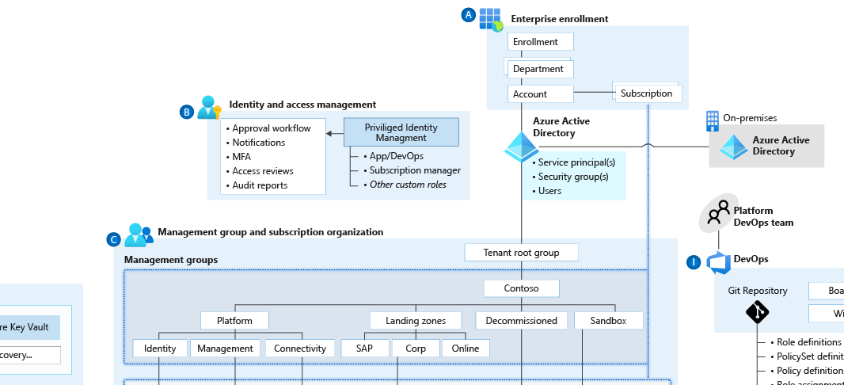

Identity & Access Management
Planning for Authentication Inside the Landing Zone
A critical design decision enterprise organization must make when adopting Azure is whether to:
extend an existing on-premises identity domain into Azure
or
create a brand new one
Notes:
Identity and Access Management in Enterprise-scale addresses Azure control plane, data plane, and application layer requirements.
Planning for Identity and Access Management begins with the Azure platform and Azure Active Directory. Many consider identity to be the primary perimeter for security. This is a shift from the traditional focus on network security. Network perimeters keep getting more porous, and that perimeter defense can’t be as effective as it was before the explosion of BYOD devices and cloud applications. Enterprise-scale recommendations focus on defining least privileged Role Based Access Control roles aligned to the customer’s operating model and leveraging Azure capabilities to apply additional layers of access control.
Use Azure AD Privileged Identity Management to establish zero standing access and to enable approval workflows for just-in-time control plane access to azure resources. Granting entitlements through PIM, rather than direct resource access, helps to protect against legacy access rights that often result from changing roles and responsibilities within an organization.
Use Azure AD PIM access reviews to periodically validate resource entitlements. Regularly scheduled reviews of access rights and entitlement use is a regulatory requirement for many customers. Determining which users had access to what resources for a given time period is much easier with PIM compared to querying AAD audit logs.
Customer RBAC roles should be used to define access rights across the Azure estate. Key roles within an organization will typically include Platform Owners, NetOps, SecOps, AppOps, and DevOps. Well defined and scoped RBAC role definitions enable subscription democratization through the segregation of duties required by an organization’s operating model.
Integrate Azure AD logs with the platform-central Azure Monitor Log Analytics workspace for audit reports and alert notifications.
Use Azure AD Managed Identities (MI) for Azure resources, avoiding username and password-based authentication. Managed Identities provide the simples and most secure method for enabling service to service communication. Managed Identities eliminate the need for credentials in your code, they rotate credentials automatically, and can be used to authenticate to any service that supports Azure AD authentication.
Multi-Factor Authentication should be enforced on all privileged accounts. If you only use a password to authenticate a user, it leaves an insecure vector for attack. If the password is weak or has been exposed elsewhere, is it really the user signing in with the username and password, or is it an attacker? When you require a second form of authentication, security is increased as this additional factor isn't something that's easy for an attacker to obtain or duplicate.
Conditional Access policies should be enforced on all privileged accounts. Azure Active Directory (Azure AD) Conditional Access (CA) analyses signals such as user, device, and location to automate decisions and enforce organizational access policies for resource. You can use CA policies to apply access controls like Multi-Factor Authentication (MFA). CA policies allow you to prompt users for MFA when needed for security and stay out of users’ way when not needed.
Planning for Authentication Inside the Landing Zone is concerned with workload access and dependencies on on-premises systems. A critical design decision enterprise organization must make when adopting Azure is whether to extend and existing on-premises identity domain into Azure or create a brand new one. Requirements for authentication inside the "Landing Zone" should therefore be thoroughly assessed and incorporated into plans to deploy AD, Azure AD-DS or both.
Examples:
Use AAD RBAC to manage data plane access to resources where possible (e.g. Key Vault, Storage Account, Azure SQL DB). Use Managed Identities instead of Service Principles for authentication to Azure services.
Evaluate the compatibility of workloads for AD and AAD-DS. Do not assume existing workloads are agnostic of AD and AAD-DS authentication, as there are differences between both approaches.
Deploy AAD-DS within the primary region as this service can be projected into only one subscription. Use Virtual Network Peering to support its usage as an authentication service.
Use Just-In-Time access for both VM access and Azure control plane administration.

Slide 29
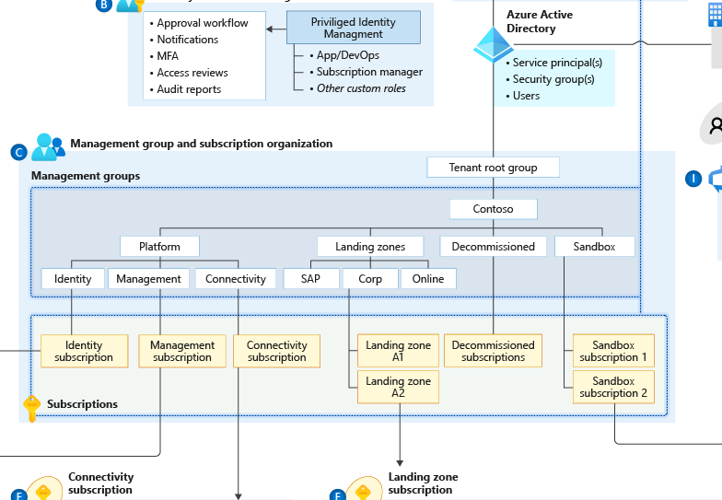

Management Group & Subscription Organization
Define Hierarchy, Quota & Capacity, and Manage Cost
Subscription Organization and Governance
Use Management Group structure, within an AAD tenant, to support org mapping
Must be appropriately considered when planning Azure adoption at-scale
Configure Subscription Quota and Capacity
Platform limits and quotas within the Azure platform for services
Availability of required SKUs in chosen Azure regions
Subscription quotas are not capacity guarantees and are per region
Establish Cost Management
Potential need for chargeback models where shared PaaS services are concerned, such as ASE which may need to be shared to achieve higher density
Shutdown schedule for non-prod workloads to optimise costs
Notes:
Main talking Points
Subscription Organization and Governance
Use Management Group structure within an AAD tenant to support org mapping
Must be appropriately considered when planning Azure adoption at-scale
Configure Subscription Quota and Capacity
Platform limits and quotas within the Azure platform for services
Availability of required SKUs in chosen Azure regions
Subscription quotas are not capacity guarantees and are per region
Establish Cost Management
Potential need for chargeback models where shared PaaS services are concerned, such as ASE which may need to be shared to achieve higher density
Shutdown schedule for non-prod workloads to optimise costs
Further Talking Point
Define Management Group Hierarchy Within an Azure AD tenant, Management Group structures help to support organizational mapping and must therefore be appropriately considered when planning Azure adoption at-scale.
Management groups can be used to aggregate Policy and Initiative assignments.
A management group tree can support up to six levels of depth. This limit doesn't include the Root level or the subscription level.
Subscription Organization and Governance Subscriptions are a unit of management, billing, and scale within Azure
Subscriptions serve as a boundary for the assignment of Azure policies.
Subscriptions serve as a scale unit so that component workloads can scale within the platform subscription limits.
Subscriptions provide a management boundary for governance and isolation, allowing for a clear separation of concerns.
Subscription Quotas and Capacity It is essential to ensure that sufficient capacity and SKUs are available. Every Azure region contains a finite set of resources at any given time.
Limits and quotas within the Azure platform for each service your workloads require.
Availability of required SKUs within chosen Azure regions.
Subscription quotas are not capacity guarantees and are applied on a per region basis.
Cost Management Cost transparency across a technical estate is a critical management challenge faced by every large enterprise organization
Using a shutdown schedule for non-production workloads to optimize costs
Using Azure Advisor to check cost optimization recommendations.
Potential need for chargeback models where shared PaaS services are concerned, such as ASE and AKS which may need to be shared to achieve higher density

Slide 30
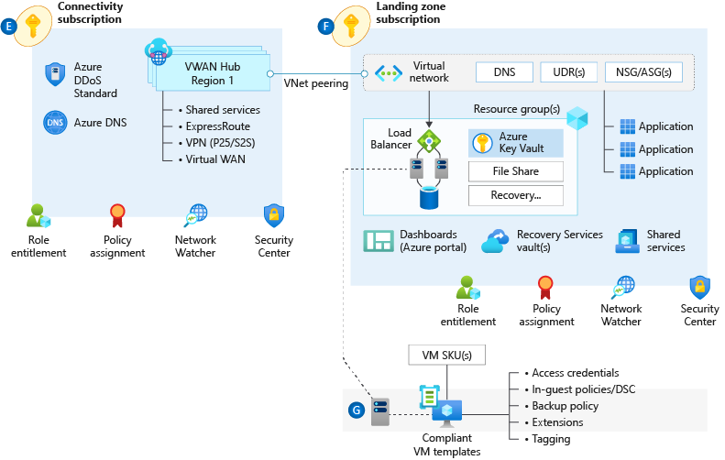

Network Topology & Connectivity
Define basic Networking Architecture
Consider the following design elements:
Planning for IP Addressing
Configure DNS
Define an Azure Networking Topology
Azure VWAN (Microsoft Managed)
Traditional Azure networking (Customer Managed)
Walkthrough – Enterprise-scale network topology (VWAN-based)
Connectivity to Azure
Notes:
Network topology and connectivity within Enterprise-scale addresses the need for establishing the end-to-end connectivity for all landing zones in the enterprise Azure estate. The subject is both broad and complex and will likely consume a significant portion of the overall design effort. It is critical for successful delivery to ensure that you have a thorough understanding of all design areas and Enterprise-scale recommendations, common alternative solutions, and the impact of deviating from the recommendations.
DNS Configuration within Enterprise-scale will be primarily influenced by the cross-premises name resolution requirements of landing zone workloads. For environments where name resolution in Azure is all that is required, native Azure DNS services should suffice. For environments where name resolution across Azure and on-premises is required, Azure VMs integrated with existing DNS infrastructure will be required. Integration with Private Link and services with special DNS requirements, such as OpenShift, must also be factored into the design.
Tip – A common scenario here is customer extends their DNS infra to Azure (Infoblox, AD, etc) but also uses the azure DNS resolver 168.* address as a forwarder for those in-azure DNS servers to assure private link resolution.
Azure Networking Topology
Azure Virtual WAN An Azure networking topology based-on Azure Virtual WAN is the preferred Enterprise Scale approach for large scale multi-region deployments where the customer needs to interconnect all their global locations on both Azure and on-premises. Azure Virtual WAN provides multiple advantages over traditional Azure networking, including:
Azure Virtual WAN is a Microsoft-managed solution, where end-to-end global transit connectivity is provided out-of-the-box. Virtual WAN Hubs eliminate the need for customers to manually setup the network connectivity. As an example, customer does not require to setup UDRs or NVAs to enable global transit connectivity.
Azure Virtual WAN greatly simplifies end-to-end network connectivity in Azure and cross-premises by creating a hub and spoke network architecture that spans multiple Azure regions and on-premises locations (any-to-any connectivity) out-of-the-box.
Azure Virtual WAN increases the limit of up to 200 prefixes advertised from Azure to on-premises via ExpressRoute Private Peering to 10,000 prefixes per single Virtual WAN Hub. The limit of 10,000 prefixes also includes VPN (S2S and P2S VPN).
Traditional Azure Networking can also be used to build a secure network foundation aligned to the Enterprise Scale design principles. A traditional Azure networking topology should be used for customers that either:
only intend to deploy resources in a few Azure regions
have no need for a global interconnected network
have a low number of remote/branch locations per region (less than 30), and/or
require full control and granularity for manually configuring their Azure network.
Tip: The decision point here is usually boils down to two things; do you want managed transit networking? If yes, then vwan. Do you need to ensure vnets cannot communicate with each other by default? (if so hub/spoke), but the details above will also impact the decision. Making sure the customer is aware of the differences will lead to the right conversation to make the decision.
Connectivity to Azure is concerned with establishing private connectivity from on-premises locations to Azure. Private connectivity options include ExpressRoute, ExpressRoute Global Reach, ExpressRoute Direct, Site-to-Site VPN, and Point-to-Site VPN. It will be necessary to fully understand the customer's various connectivity scenarios to align feature capabilities with customer requirements. Enterprise-scale design recommendations include:
Use ExpressRoute as the primary connectivity channel for connecting on-premises network to Microsoft Azure.
VPNs can be used as a source of backup connectivity to enhance connectivity resiliency and/or as a short-term solution while ExpressRoute ‘last mile’ connectivity is provisioned for customers that are not already either in a provider facility or have connectivity with an ER provider.
Use ExpressRoute Global Reach to connect large offices /regional headquarters/datacenter that are connected to Azure via ExpressRoute.
Do not use the same ExpressRoute circuit to connect multiple environments that require isolation or dedicated bandwidth, so as to avoid "noisy neighbour" risks.
Tip: A wise CSA once said “There are two types of enterprise Azure customers. Those with express route and those using a VPN while waiting for last mile connectivity.” A VPN backup of ExpressRoute is a great solution as well, but customers can also use multiple ER circuits at multiple peering locations. VPN is not a good backup to ER if the customer has the same provider for ER as for internet breakout as a provider outage will impact both.
Connectivity to Azure PaaS services can come in many forms and each service in the customer's Azure estate should be examined to ensure their requirements are met by the connectivity design. Azure PaaS services are typically accessed over public endpoints, though many PaaS services provide capabilities to secure such endpoints or even make them entirely private.
Private Link provides dedicated access using private IP addresses to Azure PaaS instances, or custom services behind an Azure Load Balancer Standard.
VNet injection provides dedicated private deployments for supported services. However, management plane traffic flows through public IP addresses. It is critical to understand how traffic routing within a virtual network can influence the management plane traffic in this scenario and affect the stability of the service.
VNet Service Endpoints provide service level access from selected subnets to selected PaaS services. When using Service Endpoints it is important to ensure concerns with data exfiltration are addressed.
Tip: Most enterprises will want to use private link wherever possible as the existence of a public IP perceived is a level of risk.
Planning for Inbound and Outbound Internet Connectivity often involves separating customers from their existing on-premises tools and practices. For example, customers will frequently want to force tunnel egress traffic back on-premises for inspection or replicate on-premises DMZ architectures in Azure. This is where we rely on the Enterprise-scale design principles to drive to a better architecture.
Azure native network security services such as Azure Firewall, Application Gateway WAF, and Azure Front Door WAF are fully managed services, meaning that customers do not incur the operational and management costs associated with infrastructure deployments, which can become complex at scale.
The Enterprise Scale architecture is fully compatible with 3rd party NVAs, should the customer prefer to use NVAs or for situations where native services do not satisfy specific customer requirements.
Tip: Many enterprise customers have 100’s of 3rd party firewalls deployed and want to maintain that ‘single pain of glass’ management for Azure. While this works and is supported 3rd party NVAs generally don’t scale as well as cloud native/first party products. Some customers have then used first party for use cases where business needs demanded better scale/throughput.
Planning for Application Delivery focuses on application delivery within the landing zone. From the Enterprise-scale perspective, application delivery services, such as Application Gateway and Front Door, are an application component and should reside within the landing zone and be managed by the application owners. By leverage Azure Policy to ensure complaint service configuration, the customer maintain central governance while enabling the business.
Azure Load Balancer (internal and public) provides high availability for application delivery at a regional level.
Azure Application Gateway allows the secure delivery of HTTP/S applications at a regional level.
Azure Front Door allows the secure delivery of highly available HTTP/S applications across Azure regions.
Azure Traffic manager allows the delivery of global applications.
It is recommended to use the WAF capabilities provided by Application Gateway and Front Door. When using both services, it is recommended to use AFD WAF, placing the protection closer to the edge.
Azure DDoS standard is recommended on all public endpoints within customer virtual networks.
Tip: A global web app would use front door to connect the user to the closest edge, then application gateway to load balance in the destination azure region.
Planning for Landing Zone Network Segmentation explores key recommendations to deliver highly secure internal network segmentation within a "Landing Zone" to drive a network Zero Trust implementation.
The Zero Trust model assumes a breached state and verifies each request as though it originates from an uncontrolled network.
An advanced Zero Trust network implementation employs fully distributed ingress/egress cloud micro-perimeters and deeper micro-segmentation.
Network Security Groups can use Azure Service Tags to facilitate connectivity to Azure PaaS services.
Use NSGs and ASGs to microsegment traffic within the "Landing Zone" and avoid using a central NVA to filter these traffic flows.
It is recommended to enable NSG Flow Logs and feed them into Traffic Analytics to gain insights into internal and external traffic flows.
For VWAN-based network topologies, route traffic across "Landing Zones" via Azure Firewall only if the customer requires filtering and logging capabilities for traffic flowing across "Landing Zones".
Tip: NSGs can be used to implement zero trust principles but keep in mind they don’t inspect traffic (I.E. if the NSG is allow 443 and a bad actor tunnels ssh through 443, the nsg will allow it where a NGFW would block it).
Network Encryption explores key recommendations to achieve network encryption between on-premises and Azure as well as across Azure regions.
Cost and available bandwidth are inversely proportional to length of encryption tunnel between endpoints.
When using VPN to connect to Azure, traffic is encrypted over the internet via IPsec tunnels.
When using ExpressRoute with Private Peering, traffic is not currently encrypted.
MACsec encryption can be applied to ExpressRoute Direct to achieve network encryption.
Azure does not currently offer native encryption over Global VNet Peering.
Tip: Ipsec can also be used on individual VMs to encrypt traffic. Also, many customers falsely assume every bit of traffic in any public cloud is encrypted by default (like storage is).
Traffic Inspection - In many industries customers require that traffic in Azure, particularly inbound and outbound internet traffic, is mirrored to a network packet collector for deep inspection and analysis. This section therefore explores key considerations and recommended approaches for mirroring or tapping traffic within Azure Virtual Networks.
Azure Virtual Network TAP (VTAP) is in preview, but your must reach to azurevnettap@microsoft.com for availability details.
Network Watcher packet captures in Network Watcher is GA, but captures are limited to a maximum period of 5 hours.
Use Network Watcher packet capture despite the limited capture window.
Evaluate if NSG Flow Logs v2 provide the level of detail required.
Use 3rd party solutions for scenarios where sustained deep packet inspection is required.
Do not develop a custom solution to mirror traffic. While this might be acceptable for small scale scenarios, this approach is not encouraged at scale due to complexity and supportability issues which may arise.
Tip: Any enterprise with a requirement for ‘deep packet inspection’ is going to use a 3rd party NVA until azfw supports it (NDA roadmap).

Slide 31
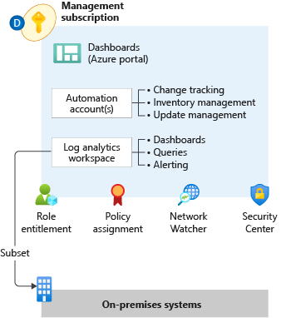

Management & Monitoring
Planning for Platform & Application Management and Monitoring
Log Analytics workspace is an administrative boundary Security audit logging and achieving a horizontal security lens across the entire customer Azure estate
Azure data retention thresholds and requirements for archiving
Notes:
Management & monitoring in Enterprise-scale is primarily concerned with how an enterprise can operationalize and centrally govern their Azure estate. Management and monitoring recommendations align to the Enterprise-scale design principles and focus on native Azure capabilities. Where customers deviate from recommendations, it is important to highlight the design complexities, administrative burden, gaps in observability, and costs of third-party solutions. Defaulting to a customer’s existing toolset often proves challenging and slows adoption.
Role Entitlement
Role entitlement refers to the implementation of fine-grained RBAC controls, with appropriate access at the appropriate scope, in conjunction with PIM and aligned with the operating model. Within the context of the Management subscription, the focus of Enterprise-scale is on providing central IT with visibility across the platform to ensure the enterprise Azure estate can be operationally maintained. Areas of visibility include audit logs, patch status, and security alerts.
Policy Assignment
Policy assignments establish the guard rails that allow for subscription management to be distributed while remaining centrally governed, enabling subscription democratization. Within the context of the Management subscription, the focus of Enterprise-scale is on ensuring the appropriate resources are in place and ready for consumption by platform services and landing zones.
Archetype Templates
Management and monitoring within Enterprise-scale must be designed with application archetypes in mind. Every large-scale enterprise software estate will encompass a myriad of application archetypes, and each archetype may require a different migration/transformation path to Azure; a VM workload is not migrated the same way as SAP workloads. The management and monitoring design must account for these differences to ensure the proper guard rails and observability are in place and ready to consume at time of landing zone deployment.
Azure Monitor Logs (aka Log Analytics)
Centralized logging is critical to the visibility that's required by the operations management teams. The centralization of logging drives reports about change management, service health, configuration, and most other aspects of IT operations. Converging on a centralized workspace model reduces administrative effort and reduces the chances for gaps in observability.
Log Queries help you to fully leverage the value of the data collected in Azure Monitor Logs. A powerful query language allows you to join data from multiple tables, aggregate large sets of data, and perform complex operations with minimal code. Virtually any question can be answered, and analysis performed if the supporting data has been collected, and you understand how to construct the right query.
The goal of alerting is notification for significant events. Azure Monitor provides a unified alerting experience across platform and resource, with activity logs, metrics, and resource logs signal types.
Metric alerts in Azure Monitor work on top of multi-dimensional metrics. These metrics could be platform metrics, custom metrics, popular logs from Azure Monitor converted to metrics and Application Insights metrics. Metric alerts evaluate at regular intervals to check if conditions on one or more metric time-series are true and notify you when the evaluations are met. Metric alerts are stateful, that is, they only send out notifications when the state changes.
Log search rules are created by Azure Alerts to automatically run specified log queries at regular intervals. If the results of the log query match particular criteria, then an alert record is created.
Activity log alerts are alerts that activate when a new activity log event occurs that matches the conditions specified in the alert.
Dashboards
The goal within Enterprise-scale for visualizations is a curated set of dashboards built for specific personas in the operating model.
Azure Workbooks are the platform visualization capability where current development efforts are focused.
Workbooks provide a flexible canvas for data analysis and the creation of rich visual reports within the Azure portal. They allow you to tap into multiple data sources from across Azure and combine them into unified interactive experiences.
Workbooks can query data from multiple sources within Azure. Authors of workbooks can transform this data to provide insights into the availability, performance, usage, and overall health of the underlying components. For instance, analyzing performance logs from virtual machines to identify high CPU or low memory instances and displaying the results as a grid in an interactive report.
But the real power of workbooks is the ability to combine data from disparate sources within a single report. This allows for the creation of composite resource views or joins across resources enabling richer data and insights that would otherwise be impossible.
Workbooks are currently compatible with the following data sources:
Logs
Metrics
Azure Resource Graph
Alerts (Preview)
Workload Health (Preview)
Azure Resource Health (Preview)
Azure Data Explorer (Preview)
Automation Accounts
Centralized Azure Automation accounts provide application landing zones with easily consumable management services, and they provide central IT with the visibility and control required to ensure compliance with enterprise standards. Integration with Azure Policy ensures resources are configured correctly at time of deployment.
Update Management in Azure Automation can be used to manage operating system updates for Windows and Linux machines in Azure, in on-premises environments, and in other cloud environments.
Inventory Management in Azure Automation provides the ability to collect and view inventory for software, files, Linux daemons, Windows services, and Windows Registry keys on your computers.
Change Tracking in Azure Automation provides insight into changes to Windows software, Linux software packages, Windows and Linux files, Windows registry keys, Microsoft services, and Linux daemons on your computers.
Network Watcher
Azure Network Watcher provides tools to monitor, diagnose, view metrics, and enable or disable logs for resources in an Azure virtual network. Network Watcher is designed to monitor and repair the network health of IaaS (Infrastructure-as-a-Service) products which includes Virtual Machines, Virtual Networks, Application Gateways, Load balancers, etc.
Security Center
Azure Security Center also plays an important part in your monitoring strategy. It can help you monitor the security of your machines, networks, storage, data services, and applications. Security Center provides advanced threat detection by using machine learning and behavioral analytics to help identify active threats targeting your Azure resources. It also provides threat protection that blocks malware or other unwanted code and reduces the surface area exposed to brute force and other network attacks.
When Security Center identifies a threat, it triggers a security alert with steps you need to take to respond to an attack. It also provides a report with information about the threat that was detected.

Slide 32
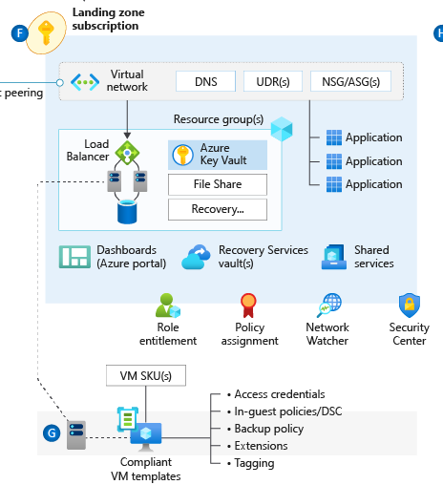

Business Continuity & Disaster Recovery
Planning for BCDR
Application and data availability requirements:
BCDR for PaaS services and the availability of native DR and HA features
Support for multi-region deployments for failover purposes
Application operations with reduced functionality or degraded performance in the presence of an outage
Notes:
Having a business continuity and disaster recovery plan is essential for organizations as it aids in the time it will take for an organization to resume work in the aftermath of an unforeseen outage or disaster. Organizations are required to define their recovery time objective (RTO) which is the time it takes for an organizations infrastructure to recover and the recovery point objective (RPO) which measures the amount of data loss after the outage or disaster for their application and data availability during the planning phases for their BCDR plan. Application and data availability requirements will differ from organization to organization based on their RTO and RPO requirements. Microsoft Azure's backup service and Azure Site Recovery service both make up the Business Continuity and Disaster Recovery solution in Azure.
This diagram is a holistic review of Enterprise-scale, the section that is relevant to Enterprise scale is what has been highlighted, the backup policy. Backups of an organizations data is a must and critical for the restoration of data.
Backup policies in Enterprise-scale are guardrails that enable and enforce backups.
The backup policy should be configured to align with the organizations recovery point objective (RPO).
Azure backups for PaaS services eliminates the need for 3rd party backup software.
Like traditional backup software, backup policies can be configured, audited, enabled, and enforced with Azure policy to enforce compliance within an organization.
Backup diagnostic data should be collected in a central Log Analytics instance to provide a horizontal view over the backup estate as a whole.
The "Deploy Backup Vault and enforce backup settings for Windows and Linux VMs" policy should be used to deploy the backup vault and enable the backup. The scope for the policy should be the landing zone management group. When used, every resource group with virtual machines in the landing zone subscription will have a backup vault for all virtual machines to backup to.
The "Add diagnostic setting to backup vault" policy should be used to link the backup vault diagnostics to the central log analytics instance. The scope that the policy should be assigned to is the landing zone management group. Doing this creates a horizontal view for all of the virtual machine backups.
When the native backup solution (Azure Backup) can't be used, other options will need to be considered to ensure data consistency and business continuity.
Why are backup policies important? A common issues across organizations when there is no enforcement of backups is that backups aren't configured or configured properly simply by human error. When there is no backup of data and\or resources, there is nothing to restore from. Backup policies eliminates the need to manually configure backups altogether. When the policy is set up, the policy configures the backup automatically.
High Availability
Applications should be deployed using availability zones within the same region
When there is an option to use replication across availability zones for native Azure services, Enterprise-scale recommends it is used. Some examples of this would be Zone redundant storage and Azure SQL DB.
Load balancers or Application Gateways should be used on the backend for stateless virtual machine workloads that are deployed across multiple instances in Availability Zones.
Application-level replication should be used for stateful virtual machine workloads across Availability Zones. An example of this would be SQL AlwaysOn.
Disaster Recovery
Applications and its corresponding data should be asynchronously replicated across multiple paired regions.
Applications architectures should enforce the use of native replication options for stateful virtual machines to replicate data between regions in region pairs. One example is the SQL AlwaysOn.
Azure Site Recovery should be used for applications to replicate stateful IaaS virtual machines that does not support application-level replication.
Externally facing applications that are required to be available always, active/active or active/passive deployment patterns across multiple regions should be utilized. Azure Front Door or Azure Traffic Manager should be used to ensure application availability should one of the regions become unavailable.
Overlapping IP address ranges must be avoided for production and DR sites to prevent connection issues.
When possible, applications should be revamped and modernized to take advantage of Azure PaaS services that provide native replication across region pairs. An example of some services that provide native replication across multiple regions are Cosmo DB, Azure SQL DB, and Azure Key Vault.
Side note: When planning for Azure Pass deployments database backups should be isolated from KeyVault backups in separate storage accounts.

Slide 33
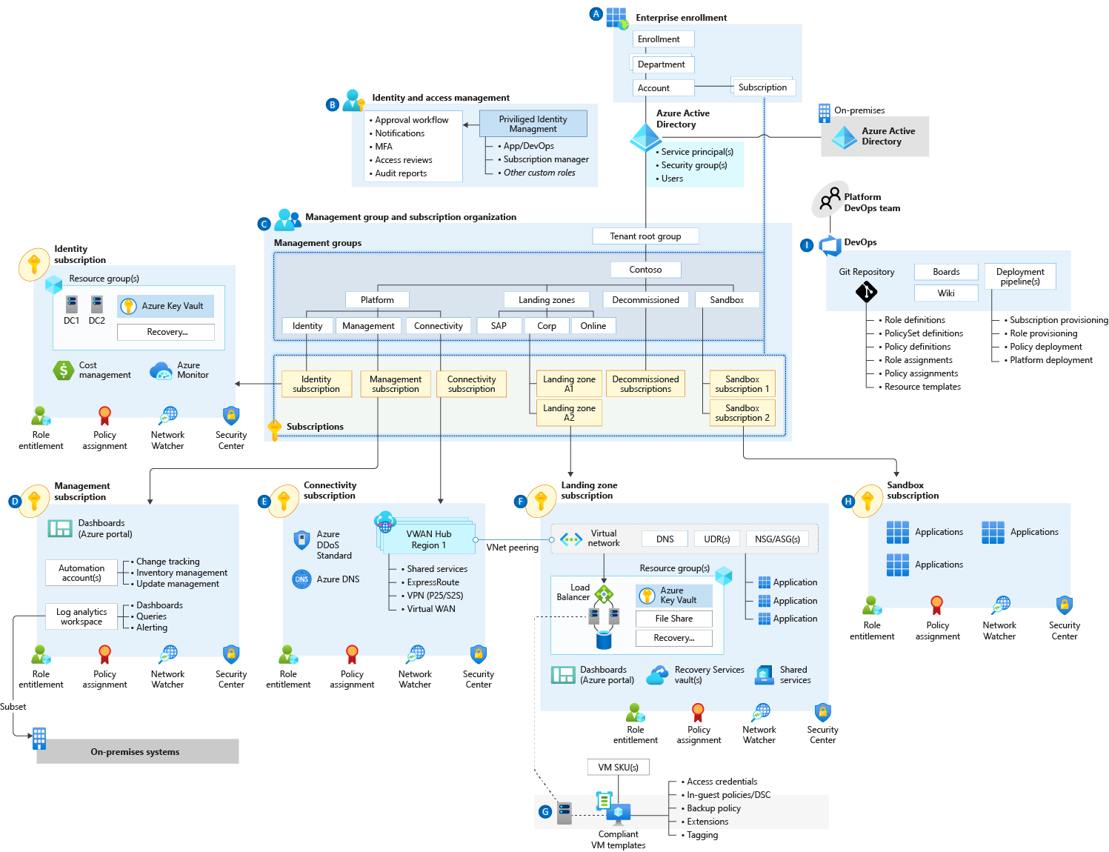

Security, Governance & Compliance
Define Encryption & Key Management
Subscription and scale limits as they apply to Key Vault
Key Vault serves a security boundary since access permissions for keys, secrets and certificates are at the vault level
Premium SKU can be leveraged where HSM protected keys are required
Key rotation and secret expiration
Use a federated Key Vault model to avoid transaction scale limits
Establish an automated process for key and certificate rotation
Notes:
TALK TRACK:
ES is secure by design leveraging
Azure DepolyIfNotExist Policies
Centralized Identity & Access Mgmt with PIM, MFA, Conditional Access to provide the components for Zero-Trust
Protect secrets with a strategic Key Vault approach
All logs go to a centralized Log Analytics Workspace
Azure Security Center for
Key Message: Key Vaults are for applications
Emphasis on central management with policies to ensure compliance and to not reach scale limits.
Key Vault should be centrally managed, but not centrally deployed.
Key Vault should not be in a dedicated subscription as a shared service.
Key Vault, by design, should be distributed across the applications that need it.
Identity & Access
Leverage PIM for roles assignments to avoid permanent access.
Use of custom roles to add granularity to the permissions

Slide 34
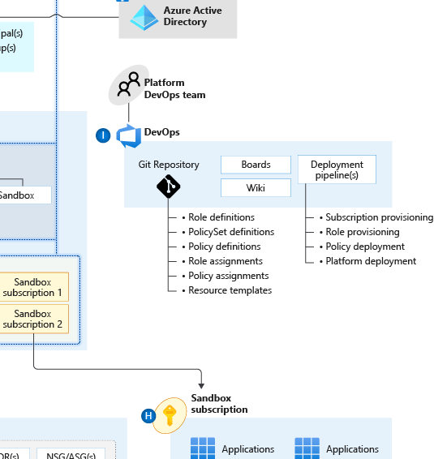

Platform Automation & DevOps
Planning for a DevOps Approach
Where central teams are concerned, CI/CD pipelines should be used to manage policy definitions, role-definitions, policy assignments, and template galleries
The blanket application of a DevOps model will not miraculously establish capable DevOps teams.
Establish a cross functional DevOps Platform Team to build, manage and maintain your Enterprise Scale architecture.
Notes:
Key Message: In Azure, everything is a resource. Management of the resources provisioning should be repeatable, consistent and versioned
Description : The image highlights the functional roles and responsibilities of a Platform DevOps Team.
Resources & Policies are deployed through ARM and centrally stored in the GIT repository seen on the left.
The right side is the automated provisioning, deployment, orchestration and lifecycles of the subscription, roles and policies.
Both together will enable teams to deploy and manage infrastructure through automation
Delineation between DevOps vs AppOps
DevOps – Application team is responsible for managing the full lifecycle of the resources created
AppOps – Some customers don't have not adopted devops and have a dedicated, centralized team to support IT operations on their behalf (E.G Backup, Tuning, Provisioning)
Identify and Access Management
DevOps/App Ops group with Contributor role assigned at RSG level

Slide 35
Implemtation Guide

Slide 36
Different altitudes of content and guidance
Aligned to CAF
Hosting Hierarchy
Guidance & Altitude
Portfolio
The collection of workloads, assets, and supporting resources, and the collection of projects, people, and processes, make the portfolio
Strategy & Plan
Cloud Platforms
Distinct deployments of the platform foundation, to govern multiple regions, hybrid solutions, or multi-cloud solutions.
Govern
Enterprise Scale
Landing Zones
Foundational services and features (or shared plumbing) that is required to support one or more workloads.
Ready
Workload
Workload is a collection of assets (infrastructure, applications, and data) that together supports a common business goal
Adopt
Well-Architected
Assets
Assets are the smallest unit of technical function supporting a workload or solution
Manage
Well-Architected
ORGANIZATION
WIDE
WORKLOAD SPECIFIC

Slide 37
Different altitudes of content and guidance
Aligned to CAF
Hosting Hierarchy
Guidance & Altitude
Portfolio
The collection of workloads, assets, and supporting resources, and the collection of projects, people, and processes, make the portfolio
Strategy & Plan
Cloud Platforms
Distinct deployments of the platform foundation, to govern multiple regions, hybrid solutions, or multi-cloud solutions.
Govern
Landing Zones
Foundational services and features (or shared plumbing) that is required to support one or more workloads.
Ready
Workload
Workload is a collection of assets (infrastructure, applications, and data) that together supports a common business goal
Adopt
Well-Architected
Assets
Assets are the smallest unit of technical function supporting a workload or solution
Manage
Well-Architected
ORGANIZATION
WIDE
WORKLOAD SPECIFIC

Slide 38
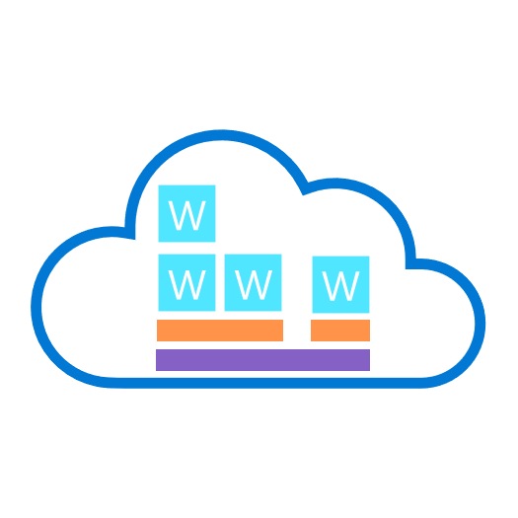
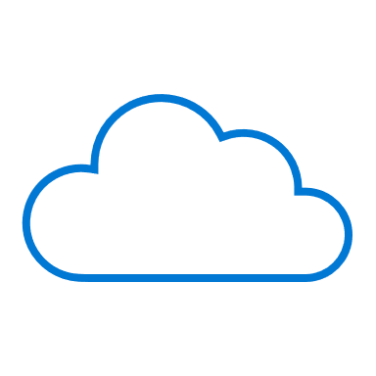
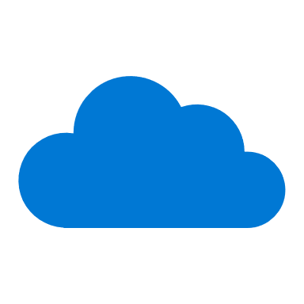


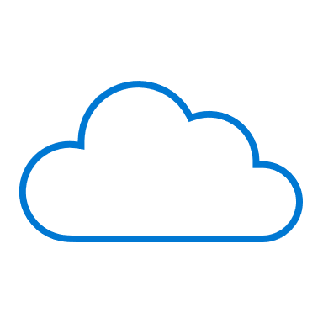

How to get started? Cloud operating model
W
W
W
W
Global Operations
Portfolio Operations
W
W
W
Central Operations
W
W
Workload
Workload Operations
Landing Zones
Platform Foundation
Notes:
<Key point>: The process of selecting a cloud operating model is different for every customer.
In decentralized models, every workload is managed on its own. Workload Operations don’t require landing zones. The Microsoft Azure Well-Architected Framework provides best practices and technical guidance to ensure workloads are high-performing, secure, and compliant workloads.
As the customer evolves their operating model, they may have Central Operations. They may have multiple workload with shared services. Workloads are running on the landing zone based on security, compliance, and governance policies of the organization. In these scenarios, we have seen implementations from CAF Migration blueprint, CAF Foundation blueprint, and even Terraform.
As customers continue in this evolution or move on to Portfolio Operations for their operating model in the cloud, things become more complex. We may have multiple landing zones operating on the platform foundation. In these scenarios, Enterprise-Scale Landing Zones have proven to be excellent solutions, providing a robust foundation to help customers manage a very complex, and growing portfolio in the cloud.
As customers move, and continue to grow in complexity, resources, and in different geographic locations (and regions), it is important that mature growth be mapped to the landing zones, supporting them as they grow.
<Transition>: Let’s look at some customer stories to learn more.

Slide 39
CAF Foundation blueprint Customer Story #1
Deployed 3 low-risk production workloads
Govern disciplines implemented
CCoE team established
Situation
Complex technical decisions
100% parity between on-prem & cloud
Week 1 | Week 4 | Week 8 | Week 12 | Week 16 | Week 20
Initial landing zone deployed
Manage disciplines implemented
Full-scale cloud deployment plan resumed
Creating landing zones unlocks cloud adoption through migration scenarios
Understand customer approach – platform development velocity
As the team gains skills & confidence, they expanded scope & took on more complex workloads
Key learnings
Notes:
<Key point>: The first customer story comes from the CAF Foundation blueprint.
The customer found themselves in difficulty. They were concerned with their on-prem operating model and wanted to move it entirely to the cloud. It didn’t work, and the customer had some additional complexities in their on-prem environment that were not easy to migrate. The customer was blocked.
The Microsoft field team approached them, and said, “Let’s go slow.”
[Microsoft speaking to customer]: “Let’s help you understand that we can’t move everything at once. This is not parity 100% from on-prem to cloud, and let’s take that journey together.”
The customer agreed, and supported the Microsoft team, who began working with the CAF Foundation blueprint.
The landing zone was deployed in one week! Three weeks later, we already had a few low-risk workloads deployed in production in the landing zone.
In a month, the value of the cloud was proven to the customer. From that point, the customer was unblocked, and felt the growing confidence within their team.
The customer experienced comprehensive support from the Microsoft team—having the environment configured properly, growing with the customer as their skills grew, helping the customer move forward with governance and principles of cloud management—all the way to creating a Central Cloud Center of Excellence (CCoE), helping them move forward and grow in their journey.
[Review Key learnings]
key messaging:
“It was important for Microsoft to understand the kind of support the customer needs—enabling the customer to feel confident, grow, and develop as their implementation and portfolio on Azure grew.”
<Transition>: Let’s look at the second customer story.

Slide 40
Enterprise-Scale Landing Zones
Customer story #2
Vision agreed on and implementation to start
Critical migration milestones completed
Additional migration and new projects
Situation
Existing ‘landing zone’, not ready for migration projects
Week 1 | Week 4 | Week 8 | Week 12 | Week 16 | Week 20
Enterprise-Scale landing zones deployed
Full-scale migration plan resumed
Creating landing zones at scale to unlock cloud adoption through migration scenarios
Understand customer approach – platform development velocity
Workshop sessions with customer to address landing zones design decisions – design areas
Key learnings
Notes:
<Key point>: The second customer story comes from the Enterprise-Scale Landing Zone.
This is a customer that is more mature. They already had several solutions, implementations, and landing zones running on Azure.
At this point, they had more important, complex, and critical projects than their previously environments on Azure. They now wanted to migrate these projects to Azure.
Therefore, the landing zones that they had already did not support these projects. The customer was blocked.
The Microsoft team, went in again, and shared the vision—the functionalities of the Enterprise Scale Landing Zones, communicating with the customer about:
The flexibility ESLZs have in their design configurations, the freedom to properly customize this robust environment to customers needs,
The thorough analysis required to define the architecture for a very robust landing zone.
Microsoft worked with the team, and worked with the customer, moving forward with a scenario where the customer was able to deploy the Enterprise-Scale Landing Zone.
The critical projects that needed to be migrated were completed in just a couple months after that.
[Review Key learnings]
key messaging:
“Not only was the customer blocked for these important projects, but they gained additional levels of confidence to move into new projects.”
“Microsoft is working with this customer in particular—working with them now on SAP and WBD projects that were not close to being considered.”
“This scenario is critical. Of course we are helping customers move forward with landing zones and deploying at scale. What was a good learning process for the team was the collaboration with the customer! It was not a simple one, two, three recipe. It was important to talk, and work with the customer in these working sessions—working with them, workshop-style, defining those landing zones, together.”
There are a lot of great opportunities with technology and technical guidance from Microsoft Azure—helping customers to move forward in their cloud journey.

Slide 41
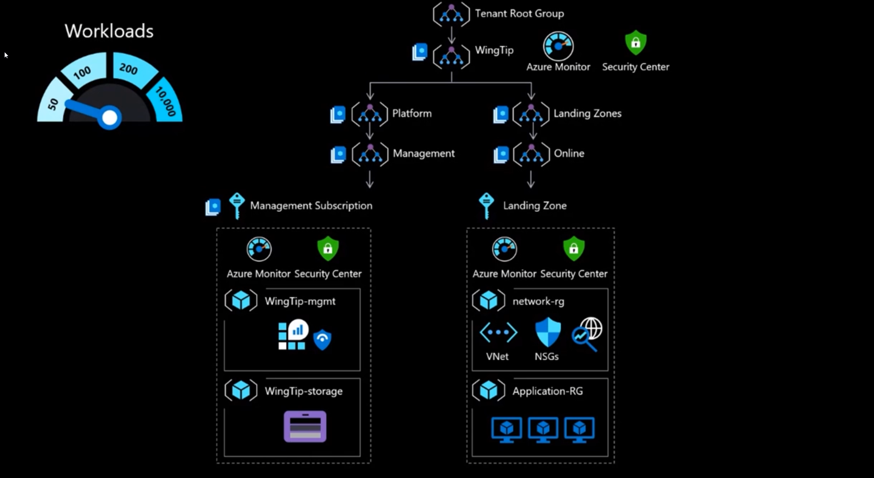

Slide 42
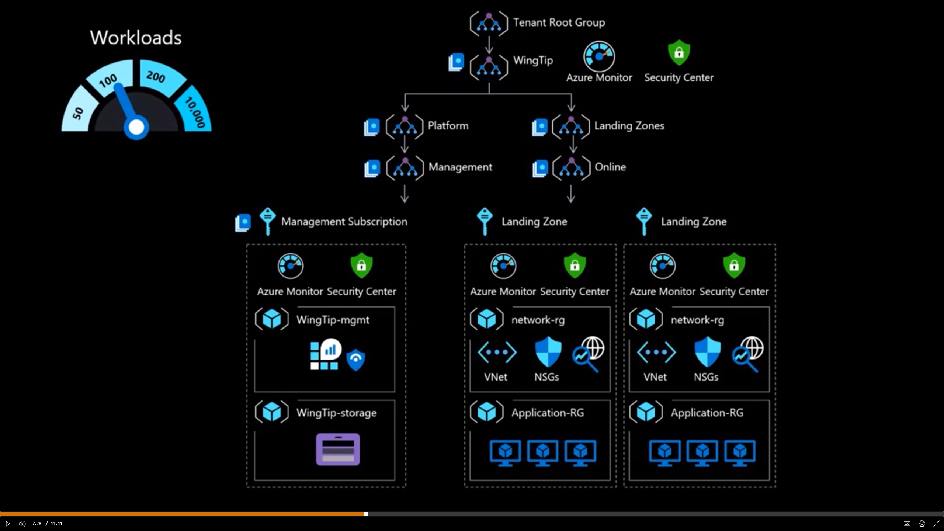

Slide 43
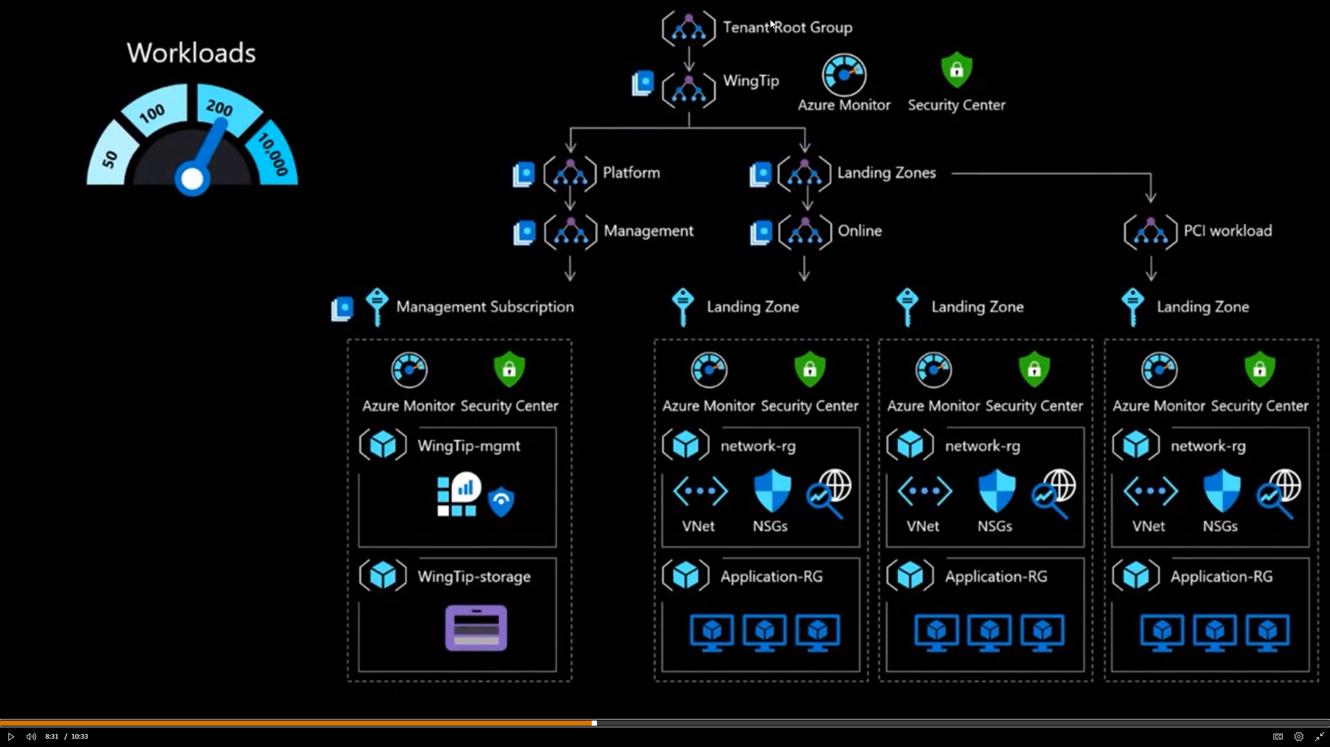

Slide 44
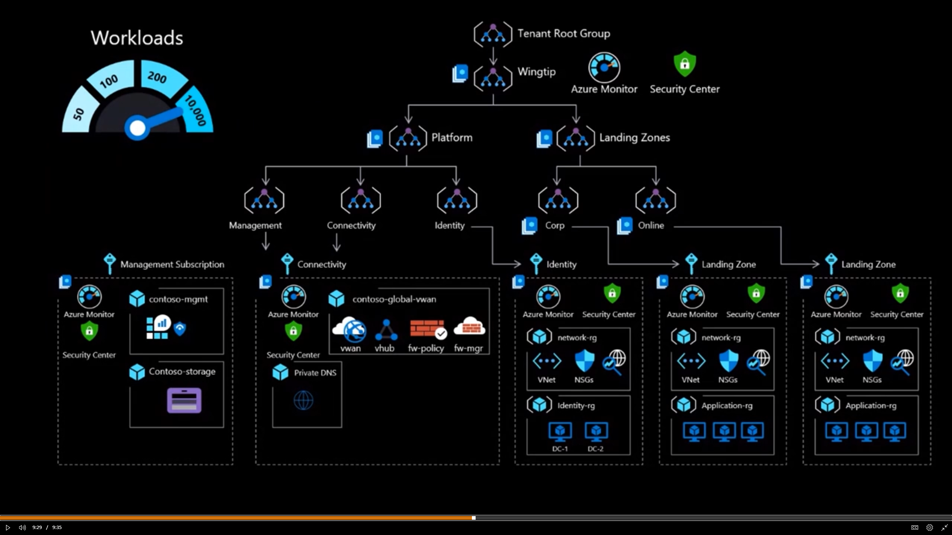

Slide 45
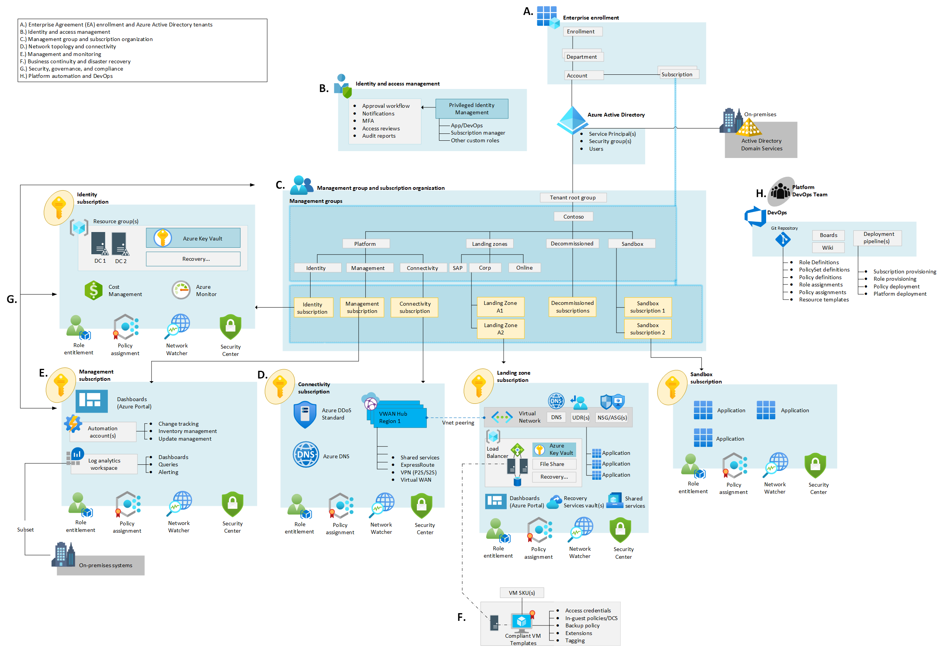

Slide 46
Demo Start with Enterprise Scale ARM Templates

Slide 47
Enterprise-scale Reference Implementation: Unblock & Accelerate to Production
1st Party reference implementation of Enterprise-scale
1
2
Git -> Clone -> Azure / Enterprise-scale
ARM as orchestrator to declare Goal-state at all 4 scopes: Tenant > MGs > Subs > RGs
Configuration, Drift Detection, & Reconciliation
Git > Commit is now “Az Deploy”
Git repository scoped at customer AAD tenant for all Azure infrastructure
Discover the existing Azure environment as-is
Turn on the lights for existing resources & configuration
E2E orchestration to deploy
Integrated CI/CD pipeline with File > New Regions & Landing Zones i.e. subscriptions
Autonomous Landing Zones – Enforced by Azure Policy in platform
Azure Engineering & platform roadmap aligned
Azure-Native immutable configuration in Git
Native platform capabilities for what-if, rollback, rollforward & complete mode
Inclusive of DevOps (Git) & ITPros (Portal)
Consistent export of all resources at all scopes across the tenant with implicit dependencies

Slide 48
Different altitudes of content and guidance
Aligned to CAF
Hosting Hierarchy
Guidance & Altitude
Portfolio
The collection of workloads, assets, and supporting resources, and the collection of projects, people, and processes, make the portfolio
Strategy & Plan
Cloud Platforms
Distinct deployments of the platform foundation, to govern multiple regions, hybrid solutions, or multi-cloud solutions.
Govern
Enterprise Scale
Landing Zones
Foundational services and features (or shared plumbing) that is required to support one or more workloads.
Ready
Workload
Workload is a collection of assets (infrastructure, applications, and data) that together supports a common business goal
Adopt
Well-Architected
Assets
Assets are the smallest unit of technical function supporting a workload or solution
Manage
Well-Architected
ORGANIZATION
WIDE
WORKLOAD SPECIFIC

